Slide 1

Visualization tool Back end & Admin organization
Different fabrics will have different design features
Basic sewing instructions remain
Same fabric but different basic pocket position designs
New sewing instructions need to be added to
Excisting instructions
New designs

Slide 2
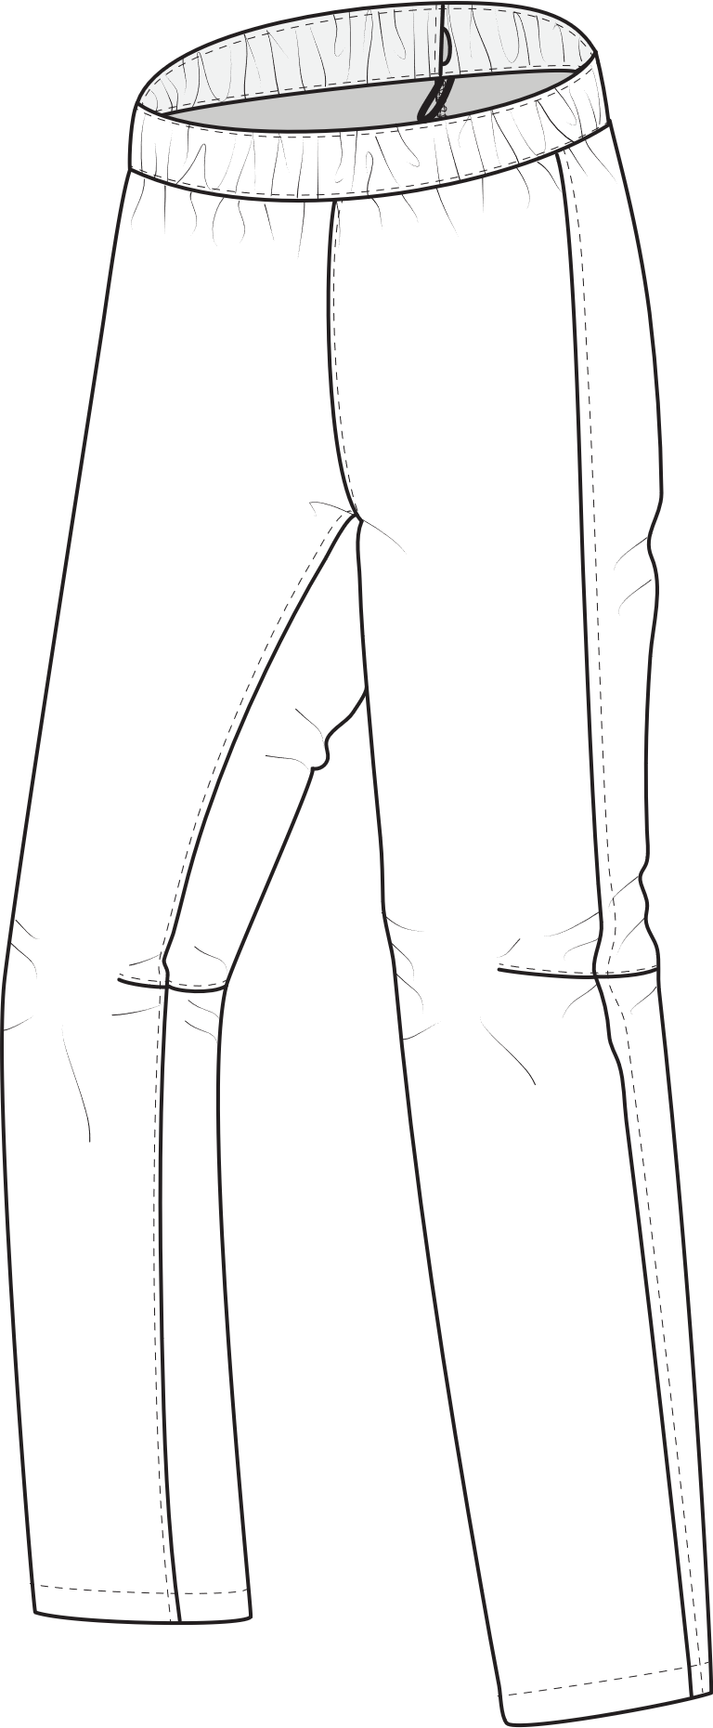
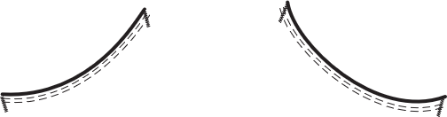
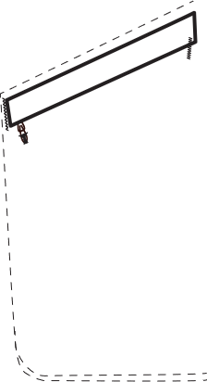
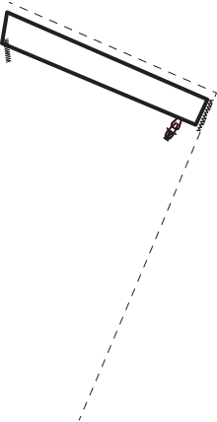
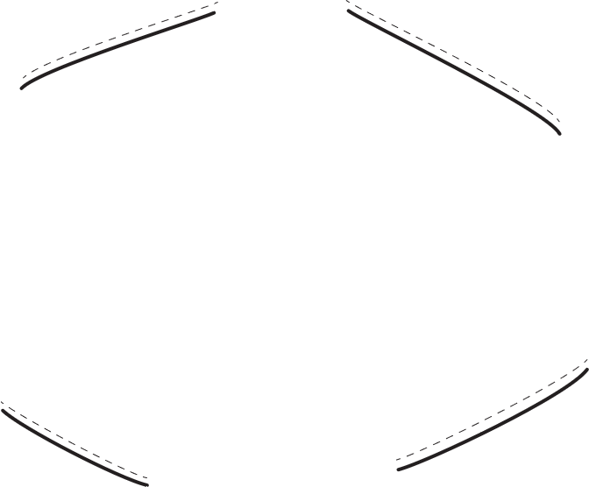
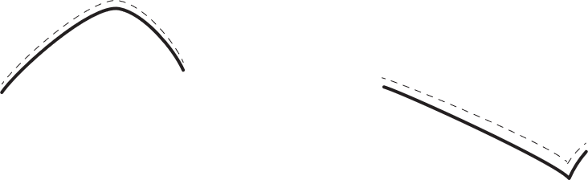
Example of design features for different fabrics
e.g. Stretch or non stretch
Light, mid or heavy weight
...
Yellow Example
Waist 3
Thigh zip pocket left:
Size 20 cm wide + 22 cm long
Shaped knee
Violet Example
Waist 3
Hand pockets round
Thigh zip pocket right: Size 18 cm wide + 20 cm long
Shaped knee
Design seams : knee
Reinforcement: hem
Extra feature: Cording in hem
P
Pattern
Pattern pieces
Main:
Waistband
Front pants
Backpants
Customer features:
Thigh pocket
P
Pattern
Pattern pieces
Main:
Waistband
Upper front pants
Lower front part
backpants
Customer features:
Hand pockets
Thigh pocket
Knee design seams
Hem reinforcement

Slide 3
Category
”Start pages”
Order 1-4 does not change
Yellow example
Violet example
1
2
3
4
Cover page
Image of design by customer/default
Title
Gender
Short discription
Specs
Difficulty
Fabric choice
Tools needed
List
Material needed
xx m fabric 1
xx m fabric 2
xx m fabric 3
thread
xx ……..
xx …..
Getting started
Pattern print out
Pattern pieces
Pattern assembly
Cutting out the pattern
Fabric layout
Pattern layouts on fabrics
Cutting the fabric
???
Image change for layout
Image change for different product groups
Image change
xx =links update

Slide 4
Category
Sewing
1
Order changes depending on customer design
I select the sewing order manually for the possible design options
Options chosen within a group (hand, thigh, seam...) do not change the sewing order
Fitting
Standard
Sew
Sewing instructions
P
Pattern
Sew
Pockets
1
2
2
Hand
Design 1 (Straight)
Design 2 (Round)
Design 3 (Angled)
Design 4 (Zip visible)
Design 5 (Zip covered)
???
Inside in hand
Standard
Zip
Simple
???
Thigh
Zip covered
Zip /flap
Bound / flap
Cargo / flap
Cargo / zip + flap
???
Inside in thigh
Standard
Zip
Simple
???
Seam
Side seam
Inseam
Waist edge
???
???
Position choice:
Left / right
Sew
P
Position choice:
Left / right
Position choice:
Left / right
Position choice:
Left / right
Sew
P
Position choice:
Left / right
Size choice:
Width / length
Size choice:
Width / length
Size choice:
Width / length
Sew
Size choice:
Width / length
P
Sew
Choice:
Velcro / zipper
P
Sew
If no ”hand pockets” chosen, this category starts with ”thigh pockets”
P
Size
A pull down option, with measurments given by me for width and length
If ”hand pockets” chosen, this category starts with ”hand pockets”

Slide 5
3
3
4
4
7
5
5
6
6
8
7
9
Design seams
Butt
Design 1
Design 2
Knee
Design 1
Design 2
Knee darts
Back knee-seam
Side seam
Standard
Inseam
Simple
Standard
Reinforcements
3. Hem
Full
Design 1
Design 2
Partly
Design 1
Design 2
Including knee
Crotch seam front
Simple
Standard
Zipper front
Crotch seam back
Simple
Standard
Sew
Sew
Sew
Sew
Image change:
-to almost ready pants
Sew
P
Sew
P
8
10
Waistband
Waist 1
Waist 2
Waist 3
Standard 1
Standard 2
Standard 3
???
9
11
10
13
11
14
12
Hem finishing
Simple
Standard
Design 3
???
Fitting
length
Cording in hem
???
???
Fishing touches
Link to Adventure galery
Main pattern pieces
Sew
Sew
P
Sew
Sew
Sew

Slide 6
Design seams
3. Hem
Full
Design 1
Design 2
Partly
Design 1
Design 2
Including knee
Design 1
Design 2
Reinforcements
Butt
Design 1
Design 2
Knee
Knee darts
Back knee-seam
Design 1
Design 2
Flap tightening in hem
???
???
Other possible design options
for different products in the Shell pant group
Lining
Cut off zippers for shorts
Cut off zippers for calf
Suspenders
Ventilation openings in the seams
Sew
P
Sew
Sew
P
P
Sew
P
Sewin instructions
Text
Images
Link to video
Patterns
Option button for me to decide if partly available!
Pattern + Sewing instructions:
It is part of the whole customer design
To be ordered singely
The pockets can be sold also seperate, so customer can change his design even after purchase

